Slide 1





Stipendium Hungaricum
SMHN -ELTE
Mentor Network
A T E Ö T V Ö S L O R Á N D U N I V E R S I T Y

Slide 2

A network to help the cultural and educational integration
SHMN - ELTE
Was founded by the negotiations between the National Union of Students in Hungary (HÖOK) and the Ministry of Human Capacities
Financed by the Ministry for Foreign Affairs and Trade
A well-functioning and constantly improving sytem since 2019
What is the SHMN?

Slide 3






Our main goals
SHMN - ELTE
Peer assistance
Our mentors are students of the university, they can use their everyday experience to help the newcomers.
Organize cutural and touristic events
The SH Mentor Network organizes several activies for the scholarship holders. Each event organized by the Network is free.
Assist higher educational integration
One of the mentor's main task is to provide reliable information about our accademical system.
Show Hungary's geographical and historical values
Apart from the bigger programs mentors are highly motivated to show around mentees in Hungary, and let them see it's curiosities.

Slide 4
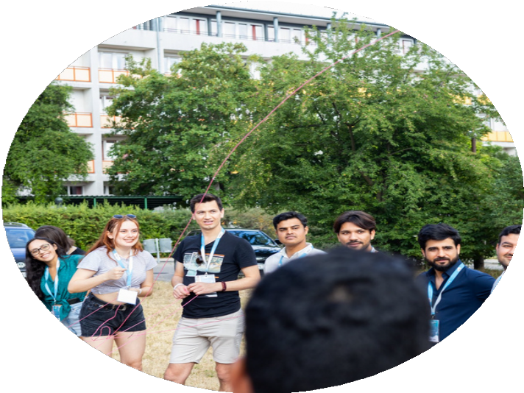


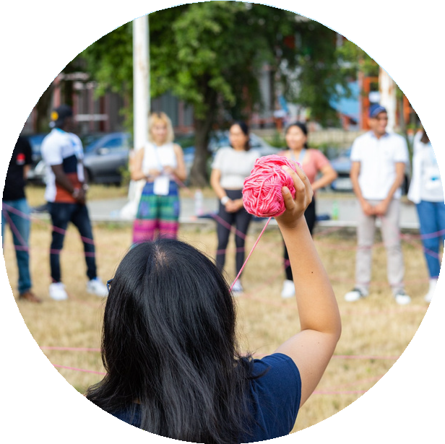

Our Mentors
SHMN - ELTE
We count over 60 mentors at ELTE, who are mostly scholarshipholders themselvs. They have alread gone through the kind of challanges what are ahead of the freshmen, so they are completely aware of the possible difficulties.
Mentors are working in pairs. Each mentor pair has around 15 mentees.
From this accademic year ELTE will have Faculty Mentors who are responsible for the given Faculty's mentoring related cases.

Slide 5
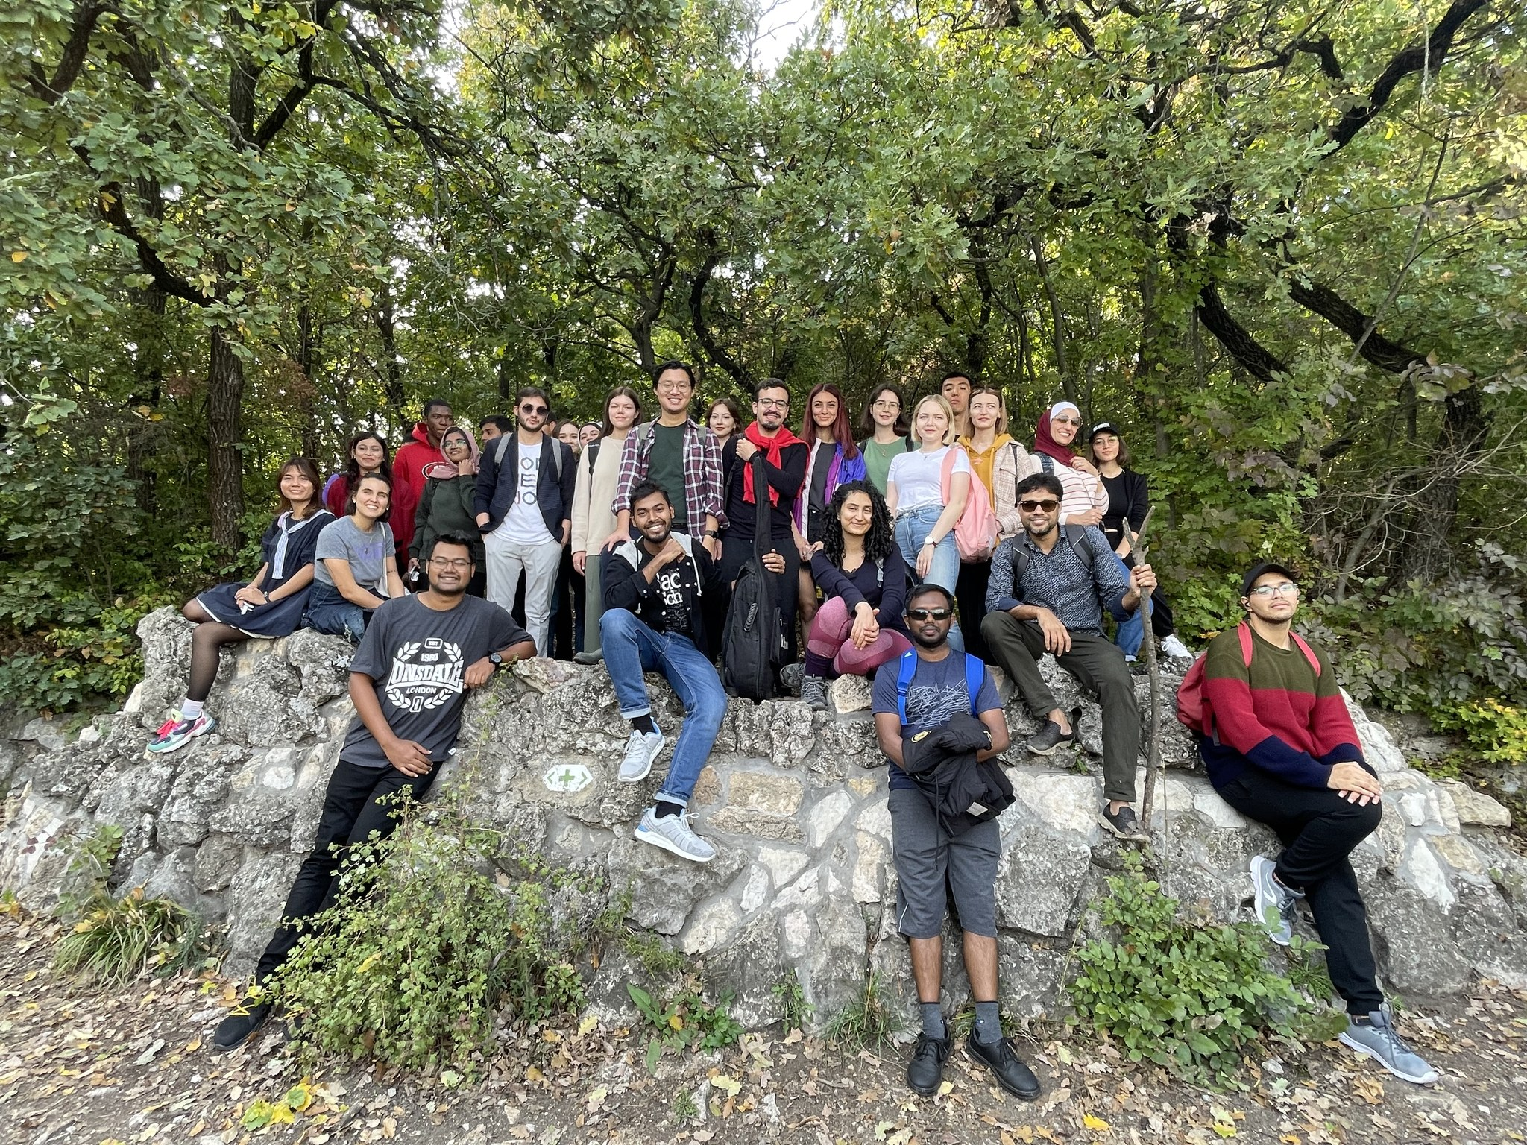
SHMN - ELTE
Our mentees
This is a picture from the SH hike, organized by us. If you become a mentee, you will get the chanche to choose from a wide variety of culutral and touristic programes.

Slide 6





Thank you for your attention!
SHMN - ELTE
You can choose your mentor here:
www.shmentor.hu
In case of any problems or questions contact us here: kovacs.luca@hook.hu

